Slide 1
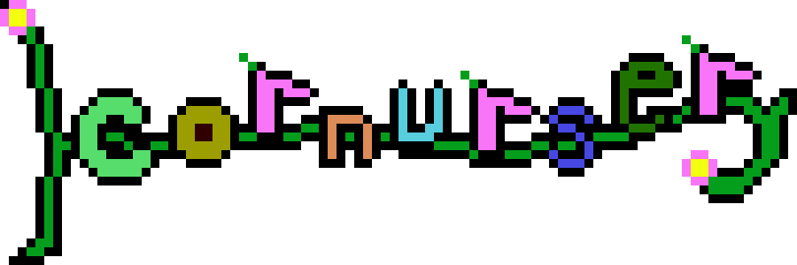
A Computer Science Capstone Project
By Rhys Cabot
(logo still pending)

Slide 2
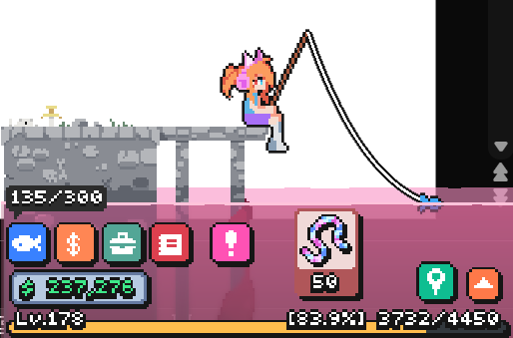
Introduction
Corner games – What are they? What do they do?
What do they get wrong?
We can improve on these
Discourage idle play
Ensure the game is not too distracting

Slide 3
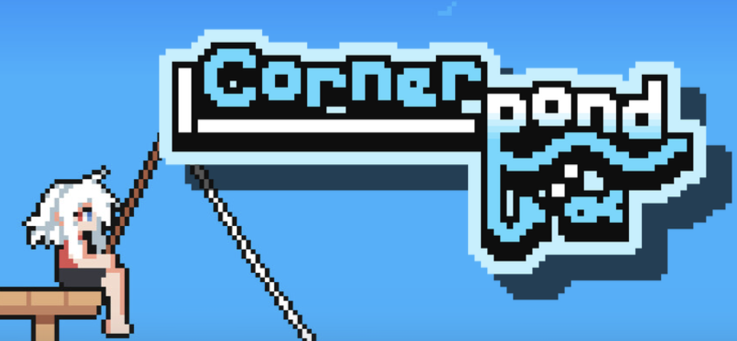
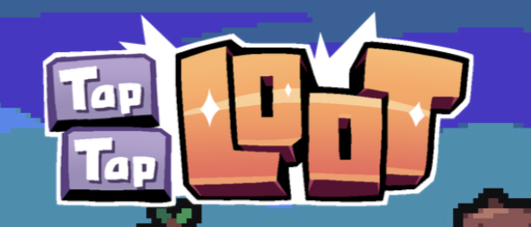
Background
Existing “Corner Games”
Cornerpond
Bongo Cat
Desktop Defender & Card Corner
Most of these examples encourage idle play as a dominant strategy
Other examples
Desktop pets
Idle games
Hotbar games
Other widgets

Slide 4
Methodology
Original approach
One plant
Placeholder sprites
Most systems are automatic
New approach!
GameData setup
Upgrades to the gameplay loop
Even when working solo – make the code readable and easy to add to
Follow OOP principles when possible

Slide 5
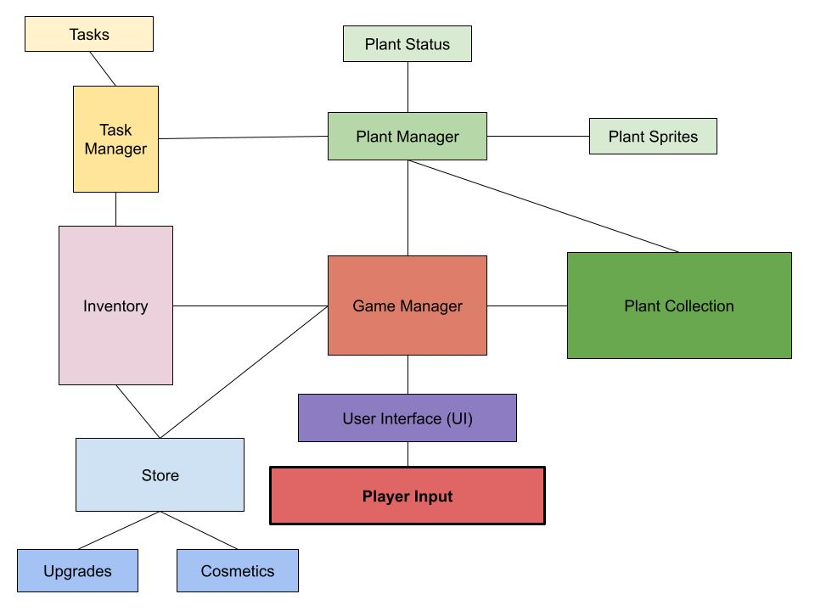
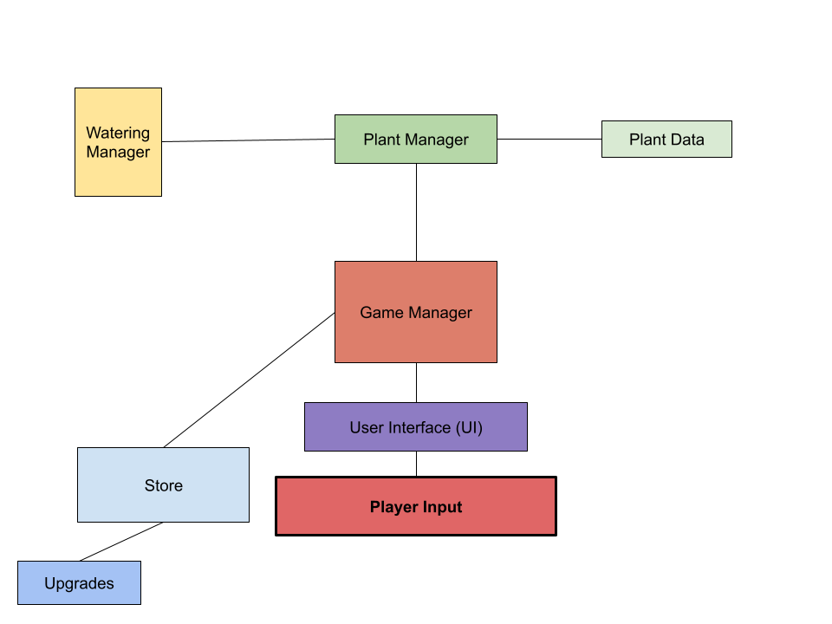
Then
Now

Slide 6
Functionality
So what does it do?
What’s the point of a controlled distraction?
When should it be used?
Does it accomplish its goals?
That kind of depends…

Slide 7
Testing & Evaluation
Who was tested?
4 testers
Given variant builds to test experimental features
What did they say?
Disappearing button/sound queue were counterproductive
Progression system would be very helpful
Takes a little too long to grow 1 plant
How did I change the project?

Slide 8
Conclusion & Future Improvements
What was accomplished?
I had to relearn Unity after 2.5 years of not touching it…again
What still can be done?
Save data
More, More, More!
Presentation! (Sound/animation)
How would I make this project professional? Could it be sold?
What features would be high priorities?

